Slide 1
Lecture #16
SOFT COMPUTING
INT508

Slide 2
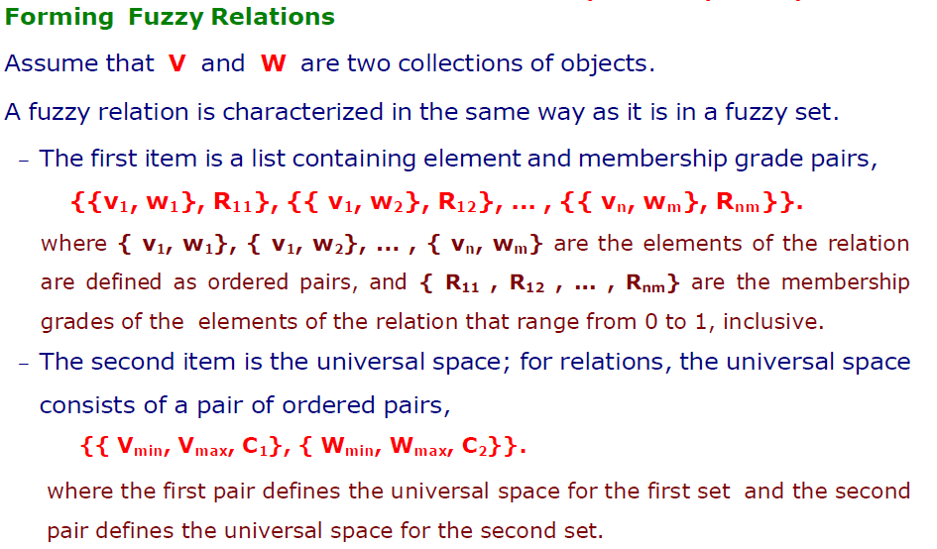
12/12/14
CSE510, Lovely Professional University, Phagwara

Slide 3
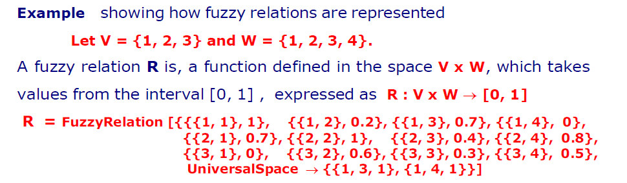
12/12/14
CSE510, Lovely Professional University, Phagwara

Slide 4
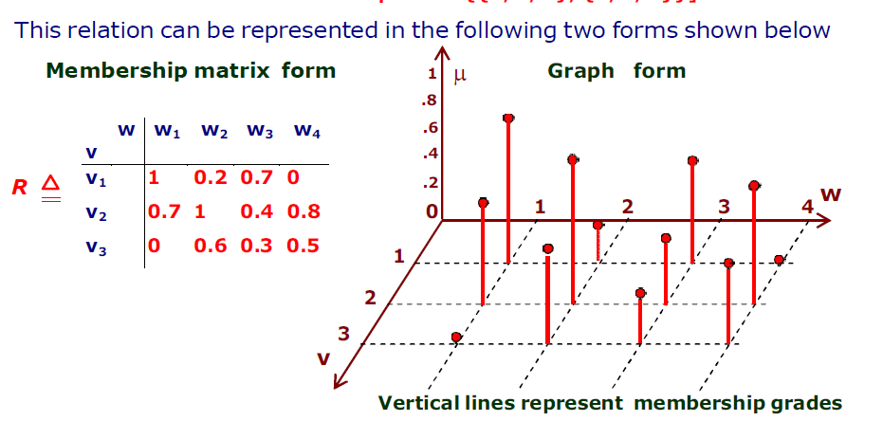
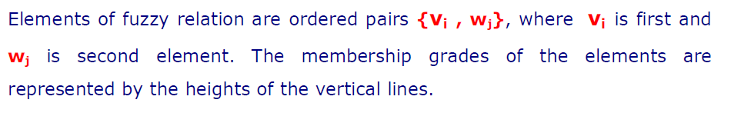
12/12/14
CSE510, Lovely Professional University, Phagwara

Slide 5
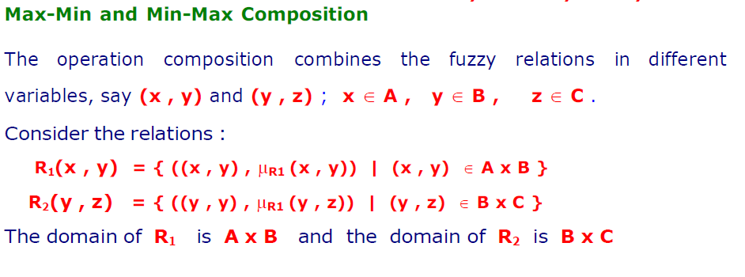
12/12/14
CSE510, Lovely Professional University, Phagwara

Slide 6
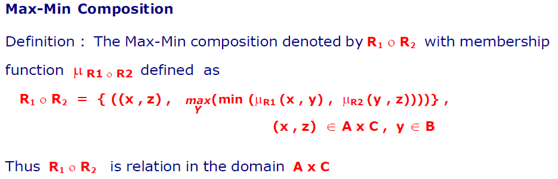
12/12/14
CSE510, Lovely Professional University, Phagwara

Slide 7
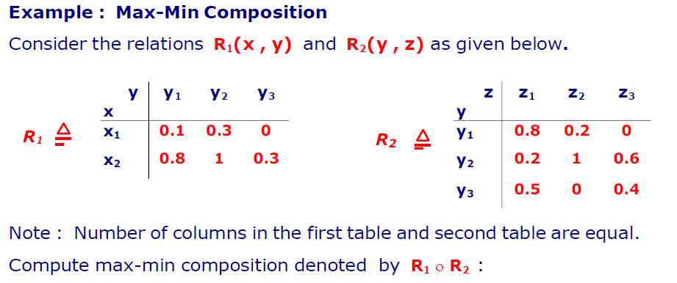
12/12/14
CSE510, Lovely Professional University, Phagwara

Slide 8
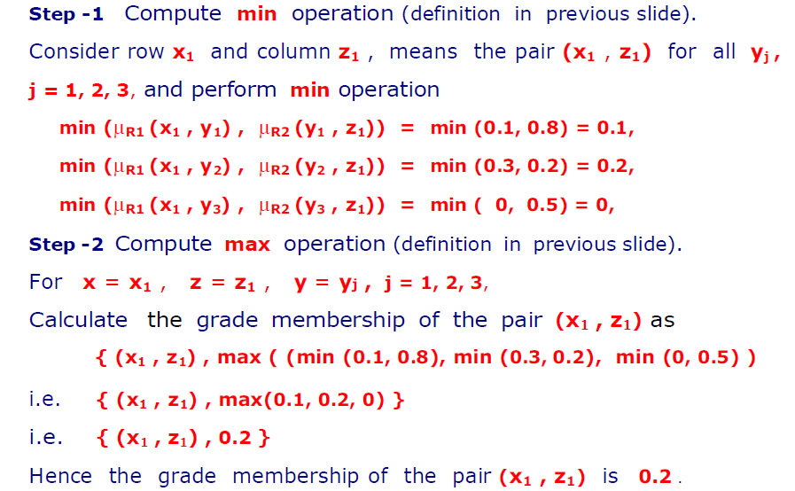
12/12/14
CSE510, Lovely Professional University, Phagwara

Slide 9
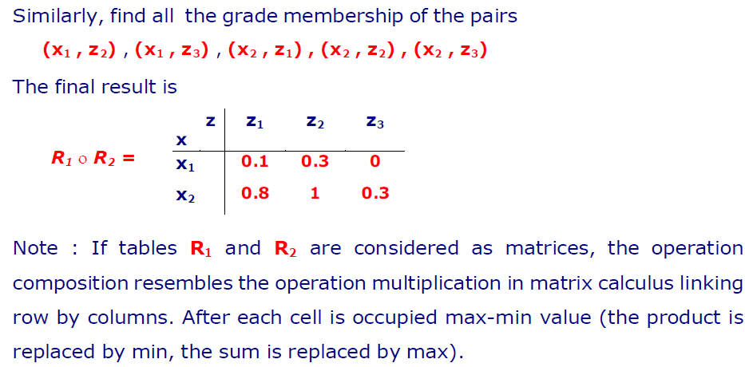
12/12/14
CSE510, Lovely Professional University, Phagwara

Slide 10
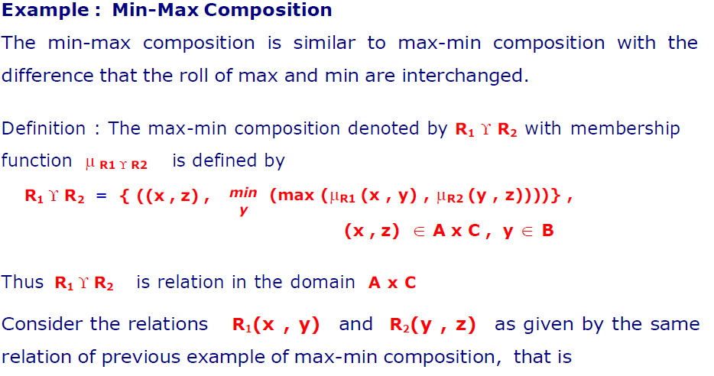
12/12/14
CSE510, Lovely Professional University, Phagwara

Slide 11
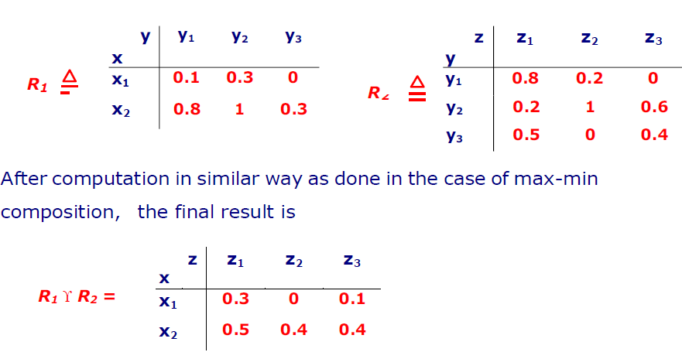
12/12/14
CSE510, Lovely Professional University, Phagwara

Slide 12
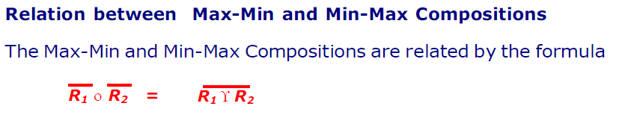
12/12/14
CSE510, Lovely Professional University, Phagwara

Slide 13
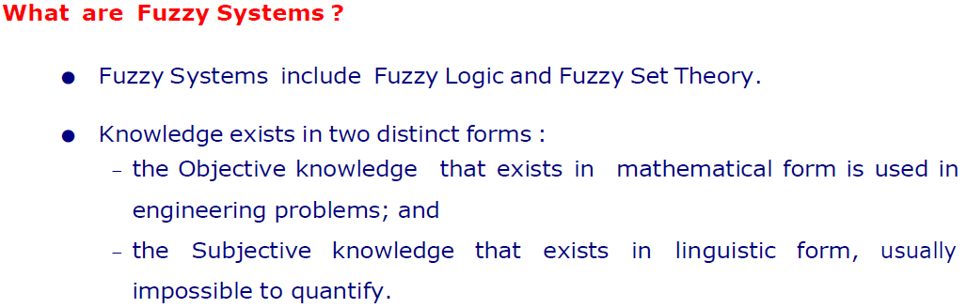
12/12/14
CSE510, Lovely Professional University, Phagwara

Slide 14
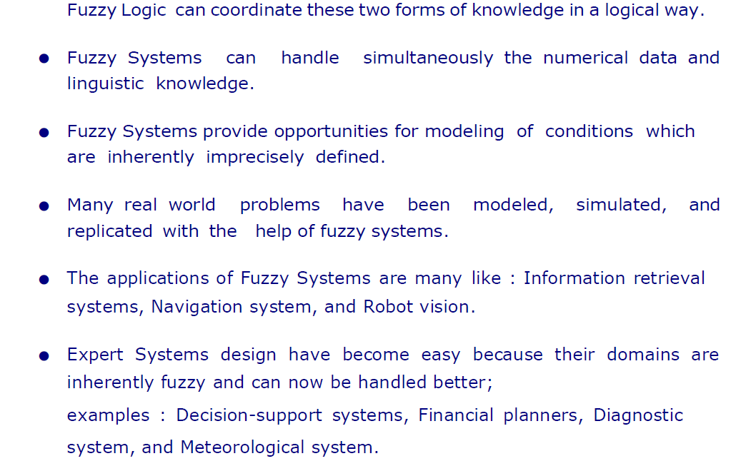
12/12/14
CSE510, Lovely Professional University, Phagwara

Slide 15
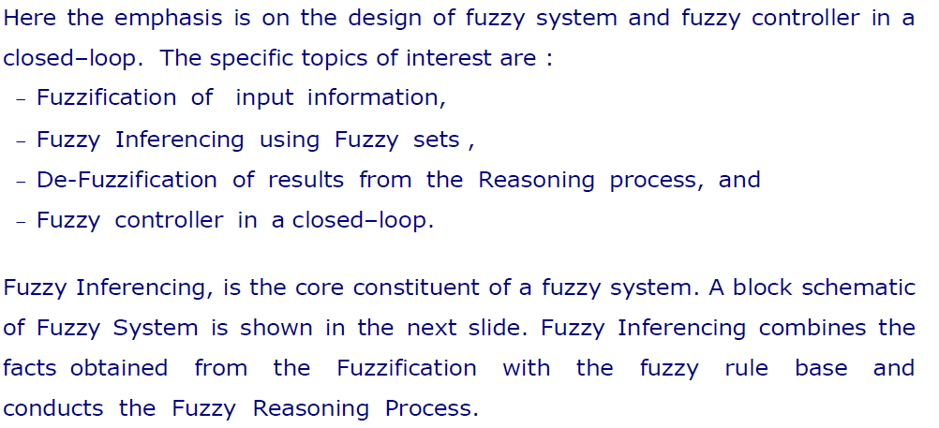
12/12/14
CSE510, Lovely Professional University, Phagwara

Slide 16
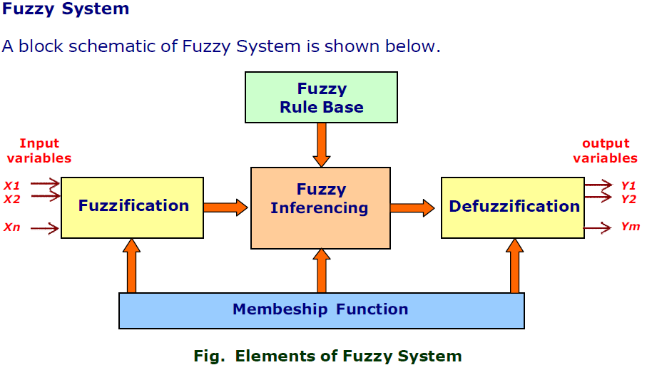
12/12/14
CSE510, Lovely Professional University, Phagwara

Slide 17
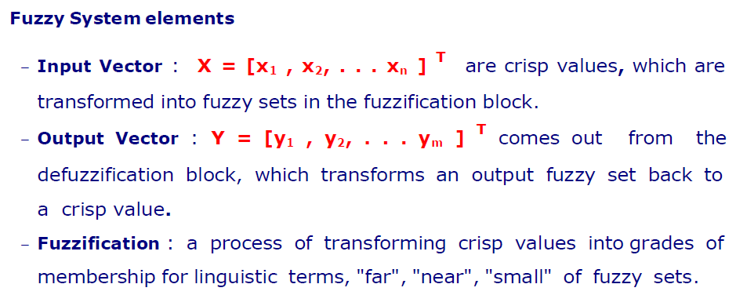
12/12/14
CSE510, Lovely Professional University, Phagwara

Slide 18
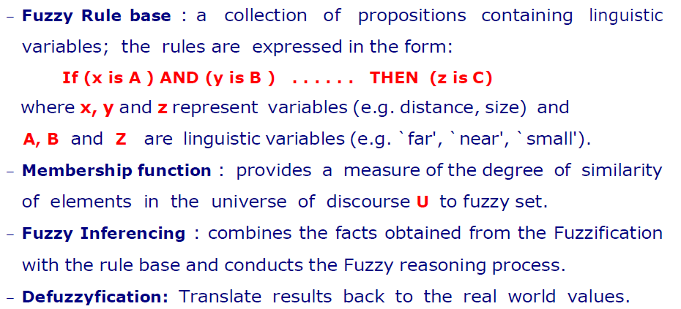
12/12/14
CSE510, Lovely Professional University, Phagwara

Slide 19
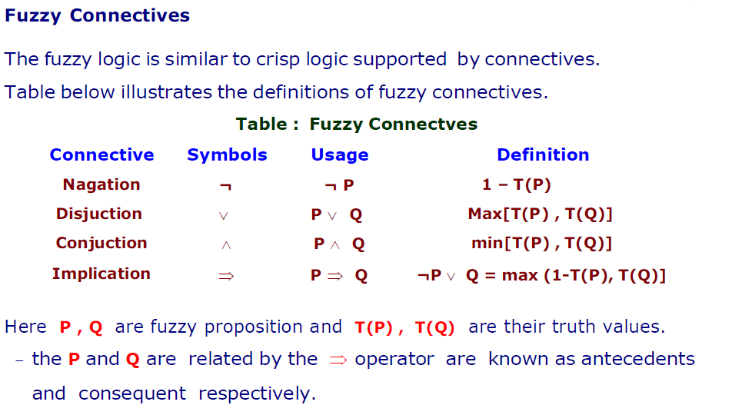
12/12/14
CSE510, Lovely Professional University, Phagwara

Slide 20
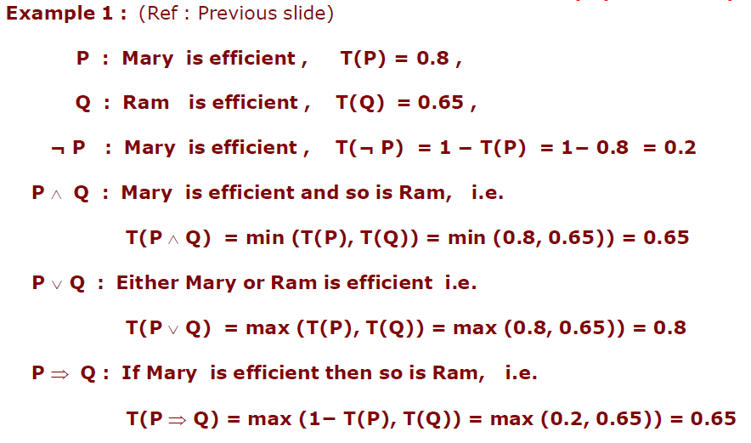
12/12/14
CSE510, Lovely Professional University, Phagwara

Slide 21
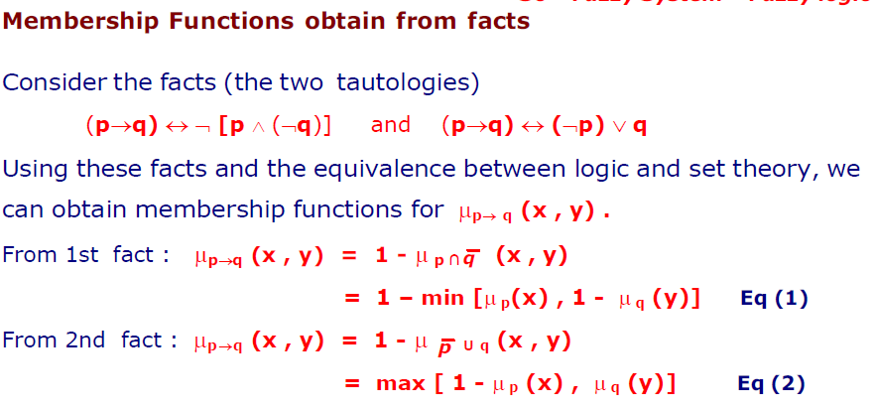
12/12/14
CSE510, Lovely Professional University, Phagwara

Slide 22
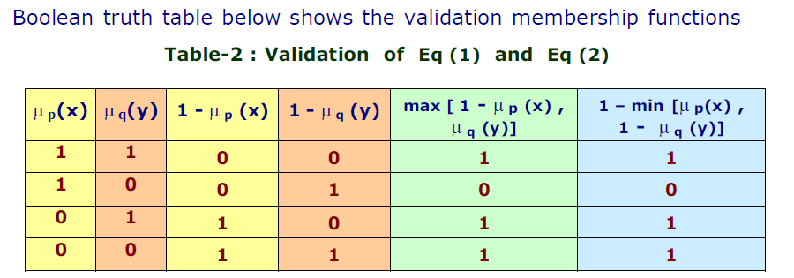
12/12/14
CSE510, Lovely Professional University, Phagwara

Slide 23

12/12/14
CSE510, Lovely Professional University, Phagwara

